Slide 1
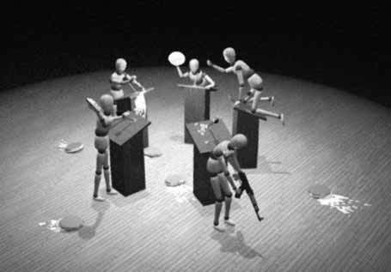
The Language of Arguments
Kareem Khalifa
Department of Philosophy
Middlebury College

Slide 2
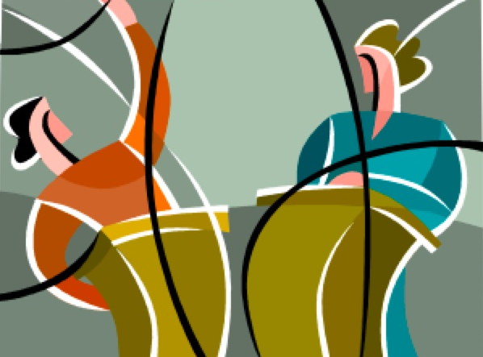
Overview
The Big Picture
Reconstructing Arguments

Slide 3
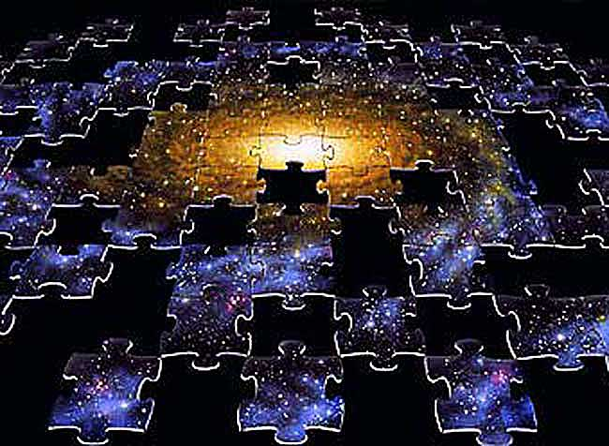
Recall the big picture…
Our goal is to ascertain when one has good reasons for believing what one believes…

Slide 4
Where we’re at in our journey…
Good reasons ≈ premises in valid arguments.
An argument is valid when, if its premises are true, its conclusion must be true.

Slide 5
Where we’re headed…
How does this relate to the kinds of things you do in most of your other courses?
For instance, how do you read, write, speak, and think in a more logical manner?

Slide 6
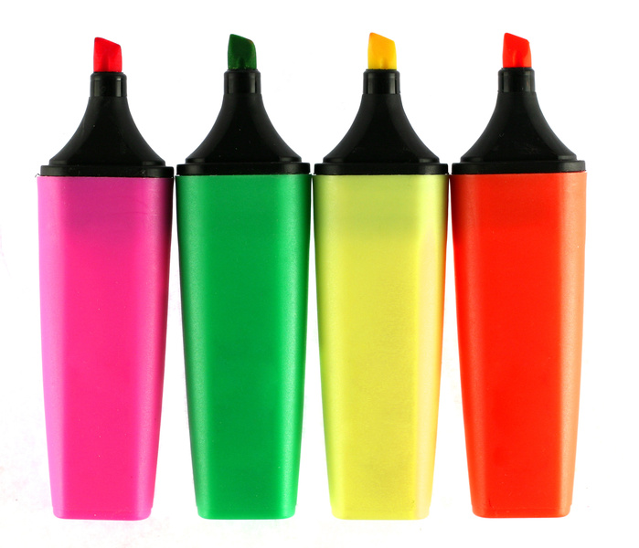
Argument Markers
This is a genus consisting of the following two species:
Premise-indicators or “reason markers”
Ex. Since, because, for, as
Conclusion-indicators or “conclusion markers”
Ex. Therefore, hence, thus, then
Notes:
When an action (paradigmatically the author’s) is being used as a reason or conclusion, that is called an argumentative performative.
Examples,
Conclusion “I conclude that…” “From this, I infer that…,”
Premise “I shall assume that…”
Don’t worry too much about this. These are just more argument markers.

Slide 7
Arguments in Standard Form
1st Premise
2nd Premise
…
nth Premise
∴ n+1. Conclusion (from 1, 2, … n)
This is one of the clearest ways of presenting an argument’s structure.
In arguments that have three premises or fewer, I’ll allow you to drop this.

Slide 8
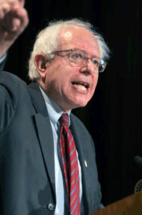
From standard form to validity
Simply putting an argument in standard form does not make it good. Example:
Bernie Sanders was once a registered socialist.
The Nazis were national socialists.
∴ Bernie Sanders was once a Nazi. (From 1,2)
The argument must also be valid.

Slide 9
From validity to soundness
Some valid arguments in standard form are not very good.
If Superman is president, then he will solve the budget crisis.
Superman is president.
∴ So Superman will solve the budget crisis. (From 1,2)
We need our arguments to be not only valid, but also sound.
Sound arguments are valid arguments with all true premises.

Slide 10
1st Lesson
As a reader, take notes by reconstructing the author’s arguments:
In standard form; and
As sound.
If you can do this, you have given a charitable reading of the author.

Slide 11
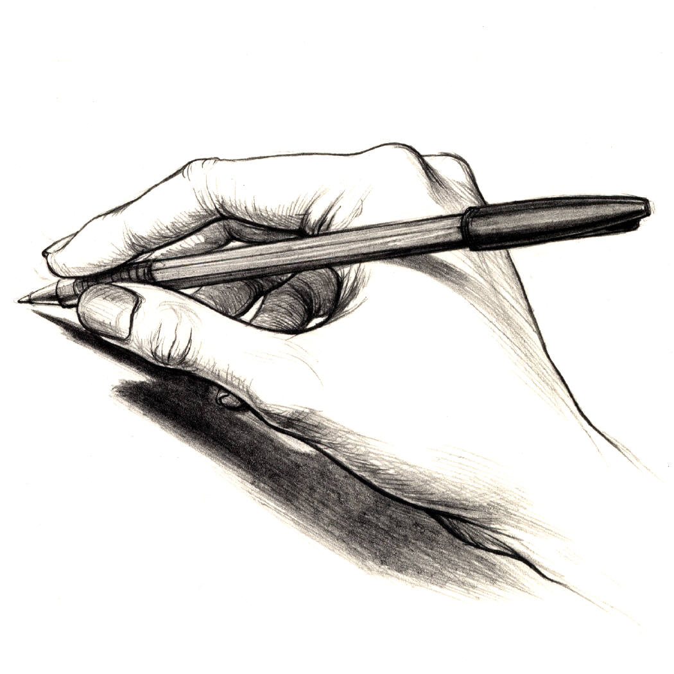
2nd Lesson
As a speaker, thinker, and (especially) writer, construct arguments that are:
In standard form; and
Sound
If you do this, then good readers will read you charitably.

Slide 12
Recap
Our goal is to apply what we’ve learned thus far to the core skills in the liberal arts: reading, writing, speaking, and thinking critically.
Present arguments (both others’ and your own) in standard form and soundly.

Slide 13
III.2
Toward evening, clouds formed and the sky grew darker; then the storm broke
NOT AN ARGUMENT; merely a sequence of events.

Slide 14
III.4
Both houses of Congress may pass a bill, but the president may still veto it.
NOT AN ARGUMENT; merely a conjunction.

Slide 15
III.6
Since Jesse James left town, taking his gang with him, things have been a lot quieter.
This one is ambiguous.
It could be regarded as NOT AN ARGUMENT, but merely as a temporal sequence; OR…
It could be regarded as an ARGUMENT, in which case “Since” is a reason-marker.

Slide 16
III.8.
Witches float because they are made of wood, and wood floats.
ARGUMENT: “Because” is a reason marker.
Witches are made of wood.
Wood floats.
∴ Witches float.

Slide 17
III.10
Joe quit, because his boss was giving him so much grief.
ARGUMENT: “Because” is a reason marker.
Joe’s boss was giving him grief.
∴ Joe quit.

Slide 18
IV.1.
Most professors are paid too little, so they are.
Invalid: Most professors may be lying when they say they are paid too little.

Slide 19
IV.8
Pat is either a mother or a father. If Pat is a mother, then she is a parent. If Pat is a father, then she is a parent. So, either way, Pat is a parent. (Assume that conclusion is true.)
SOUND. “So” is a conclusion marker.
However, what would it mean for the argument’s soundness and validity if we could not assume that the conclusion is true?
Interesting question: Could one be neither a mother or a father and still be a parent? What would this mean for the argument’s soundness and validity?

Slide 20
IV.12
There can’t be a largest six-digit number, because six-digit numbers are numbers, and there is no largest number.
ARGUMENT: “because” is a reason-marker
INVALID. Just because there is no largest number doesn’t mean that there is no largest six-digit number, viz. 999, 999.

